Slide 1

Linear Regression - II
Classical Assumptions and Non-Linearity

Slide 2
What are “Classical Assumptions”
While using OLS, we operate under the assumption that we are finding the “line of best fit” and therefore our beta’s are also BLUE.
However OLS only provides us with “best estimators” when certain assumptions hold true, these are called our classical assumptions.
For example, if our data is not linear, we cannot try and fit a linear line of best fit and expect good results.
There are 6 assumptions and we will discuss each.

Slide 3
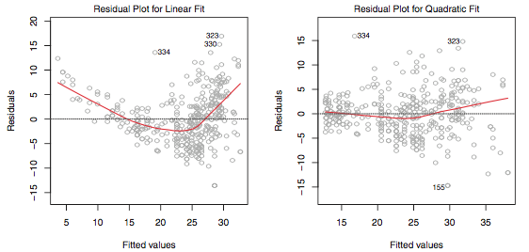
Assumption 1: A Linear Relationship Exists
The linear regression model assumes that there is a straight-line relationship between the predictors and the response. If the true relationship is non linear, then all of the conclusions that we draw from the fit are suspect.
How do we identify non-linearity? Residuals plots. That is, plotting e_{i} = y_{i} − yˆ_{i} versus the y_{actual}.

Slide 4
Assumption 1: Continued
Ok, so we have non-linearity (maybe, the relationship between income and taxes is exponential). How do we fix for it? Can we transform non-linearity?
Including exponential and polynomial terms like logX, √X, and X², help us make our model linear.
For example, we could include exponential terms to get: Y_{i} = e􏰀^{βˆ0}x^{βˆ1}e􏱃^{ϵ}
Then we can take the log of both sides: ln(Y_{i} ) = βˆ₀ + βˆ₁ x. Voila!!

Slide 5
Assumption 2: Non-Correlation of error terms
We assume that ε1, ε2, . . . , εn, are uncorrelated. When this assumption is violated we term this autocorrelation.
So autocorrelation is when the error from one observation is positive (or negative) and this fact increases the probability that the error from our next observation is also positive (or negative).
We cannot tell if correlation is present by looking at variable p-values, in fact, if the error terms are correlated, we may have an unwarranted sense of confidence in our model and beta’s would be biased.
Such correlations frequently occur in the context of time series data and not cross sectional data. For example, the price of the AAPL stock on day 1 will clearly have an impact on day 2 and maybe even day 3 and 4.

Slide 6
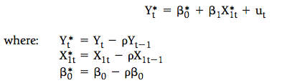
Assumption 2: Continued
So how do we identify the occurrence of autocorrelation? Again, by plotting the residuals. The residuals are our errors and our errors should not be trended in anyway but stochastic (random). So there should be no trend.
Another way is by applying the Durbin-Watson test. This is automatically reported in stastmodel.summary(). Values around 2 are desired, any value far away from 2 in either direction suggests auto-correlation.
How do we fix for it? So, a serially correlated error term is
So, our aim is to remove 𝞺𝝴_{t-1} from the error term. We do this by specifying
Notes:
In pyhton we do that by : df['lagprice'] = df['price'].shift(-1)

Slide 7
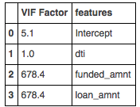
Assumption 3: Multicollinearity
In OLS we assume that no two response variables are perfect correlated. Why? Because if we use two very similar variables, like inflation % and CPI, they will artificially increase our explained sum of residuals and R²
How do we identify collinearity? The simplest method is by creating a correlation matrix of all response variables.
The other is the Variance Inflation Factor (VIF) test. Here each response variable is regressed against all other response variables. What we get is:
Notes:
A VIF factor under 10 represents little to no collinearity where as values for greater than 10 indicate multicollinearity. T

Slide 8
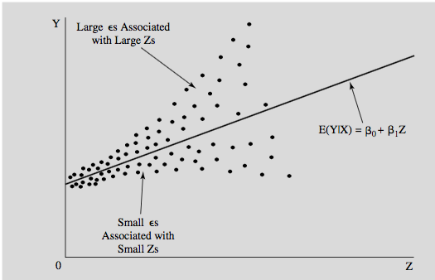
Assumption 4: Non-constant Variance of Error Terms
In OLS, we assume that the error term has a constant variance Var(ε_{i}) = σ2.
When this assumption is violated it is known as heteroskedasticity.
Again, a common way to identify if its present is to plot the residuals.

Slide 9
Assumption 4: Continued
Non-constant variances usually show up in cross-sectional studies.
For example, suppose that you’re studying the amount of money that the 29 states spend on education. Since Madhya Pradesh and UP are much more populous than Chandigarh and J&K, it’s probable that the variance of the stochastic error term for big states is larger than it is for small states.
The other way to identify is to conduct a breusch - pagan test. In this test, a hypothesis test is conducted where the null is that Variance is constant and the alternative is that variance is not constant.
The result of conducting the test is a p-value. So, if it is less than usually 0.05, we can reject the null in favor of the alternative.

Slide 10
Assumption 5: Response variables are uncorrelated with error term
(Domain knowledge)
If X1 and X2 are correlated and X2 is omitted from the equation, then the OLS estimation procedure will attribute to X1 variations in Y actually caused by X2, and a biased estimate of 􏰀βˆ₁ will result.
This violation is caused omitted variables, important variables that are left out
Take the example of a simple production function: Output = Capital + Labour
This omission of Capital would bias the estimate of the coefficient of labor because it is likely that capital and labor are positively correlated (an increase in capital usually requires at least some labor to utilize it and vice versa). The OLS program would attribute to labor the increase in output actually caused by capital to the extent that labor and capital were correlated.
Notes:
How to tell? Some indications of specification bias are obvious (such as an estimated coefficient that is significant in the direction opposite from that expected), but others are not so clear.

Slide 11

Fixing specification: Creating new but important terms
An interaction term is an independent variable in a regression equation that is the multiple of two or more other independent variables.
Example, the interactive impact of alcoholic consumption and altitude on traffic fatalities.
The interpretation of BA is this: as altitude (in thousand feet) increases, increase in alcoholic consumption increases the traffic fatalities per driven mile by 0.01 fatalities.
Notes:
Bt 􏰔 per capita consumption of beer (malt beverages) in state i

Slide 12

Fixing specification: Choose the right functional form
Sometimes, our relationship between Y and our X’s is non-linear and fitting a simple OLS leads to poor results.
Polynomial regressions: extends the linear model by adding extra predictors, obtained by raising some of the original predictors to a power. For example, a cubic regression uses three variables, X, X², and X³.
Consider the example of the relationship between Wage and Age. A simple plot show a non-linear shape, which looks very similar to the graph of -(x)² .
We can approximate, this shape by :
What would the expected signs of 􏰀Bˆ₁ and 􏰀Bˆ₂ be? Since you expect the impact of age to rise and fall, you’d thus expect 􏰀Bˆ₁ to be positive and 􏰀Bˆ₂ to be negative.

Slide 13
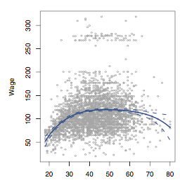
Wage vs. Age

Slide 14
Improving specification: Regression Splines
Regression splines involve dividing the range of X into K distinct regions (binning). Within each region, a polynomial function is fit to the data. However, these polynomials are constrained so that they join smoothly at the region boundaries, or knots.
So, if we made Wage (Y) a binary variable LOGISTIC FUNCTION

